Slide 1

Buildable Digital Health Blueprint
Workshop-4
Implementation Science

Slide 2

Workshop plan…
Leverage each successive workshop to progress the development of the blueprint:
Use cases (choosing our initial care pathways)
Digital health specifications (Integration Profiles)
“Building blocks” (conformant solutions)
Implementation science (making it “go”)
Each session builds on the one before it…

Slide 3

Workshop-4
Implementation Science

Slide 4
Workshop-4 Agenda
Brief recap and review
What is the present country context regarding digital data protection?
What would typically be the legal and policy basis for person-centric health data sharing?
What approaches should we favour regarding programme management and governance?
How can we build and sustain implementation momentum
What to do first, and where?
How fast to go?
Next steps

Slide 5

What current policies and laws apply to health data?

Slide 6
What are the current policies?
<leverage a desk review and pre-workshop interviews with MOH to determine the current government policies related to personal data privacy and consent management. Prepare a succinct description of the findings.>

Slide 7
Digital Data Protection Laws
The Data Protection Law notes two divisions of electronic data:
General data: defined as data which may be accessed, used and disclosed as long as the source is correctly identified;
Specific/private data: data that must not be accessed, used, and disclosed unless with the permission of the relevant data subject(s). Health data is explicitly listed as an example of specific or private data.
The Ministry of Technology and Communications (MTC) is the responsible entity regarding electronic data protection and cybercrime. Regulated activities include: data collection; verification; deposit and storage; usage and disclosure; delivery and transfer; access; and improvements and amendment (including deletion).
The Data Protection Law legally defines a Data Controller as an individual or legal entity or organization that is responsible for managing electronic data. This can include a Ministry, internet datacentre, mobile network operator, bank, etc. The data controller must have the subject’s consent in order to access, use, disclose, provide, update, terminate, edit or delete electronic date. This consent can be withdrawn.
There is no specific definition in the Law of sensitive data. All specific/private data must be handled in accordance with the following principles:
Compliance with laws, strategic plans, and national socio-economic development;
Ensuring national stability, security and social order;
Ensuring confidential and safety for government, individual and organizational data;
Ensuring the rights and interests of the data subject; and
Compliance to treaties and international agreements to which the country is a signatory.

Slide 8
Digital Data Protection Laws
Findings: UNDP Digital Maturity Assessment (DMA)
The country enacted the Electronic Data Protection Act in 2017 to strengthen protection of personal information and govern the collection, use and disclosure of electronic information. The country does not have an overall data protection law, such as the Global Data Protection Regulation (GDPR).
The Act applies to domestic or foreign individuals, legal persons or incorporated bodies who live and operate in the country. It also applies to foreign data users if they conduct business or have domestic operations.
The Act also includes key provisions on consent requirements and global digital government practices related to data transfer, retention, data erasure and breach notification.
During the DMA survey and interview sessions, it was observed that, with the exception of a few ministries and provinces, awareness regarding implementation of the laws remains low.

Slide 9
Overall eGovernment Maturity
Findings: UNDP Digital Maturity Assessment (DMA)
The country’s overall digital maturity is assessed by UNDP as Nascent at 1.7 out of 5. Provincial governments were assessed at 1.3 while the average scores across all the Ministries was 1.8.
The Ministry of Health was assessed at a digital maturity slightly below the median level.
Ministry of Health

Slide 10
What would we typically expect to be the policy basis related to person-centric health data?

Slide 11

The key elements of personal health data policy:
Health data governance policy
Health data sharing policy

Slide 12
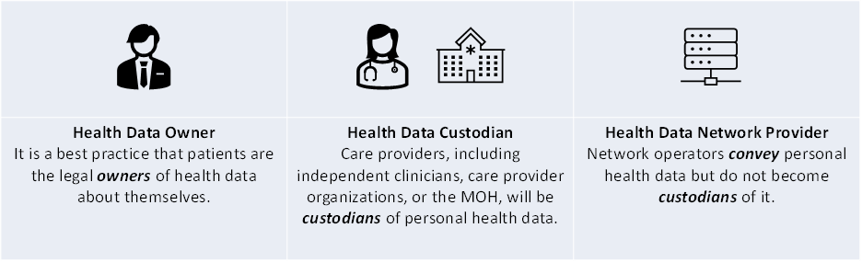
Typical Regulated Actors
Typically, as the owner of data about himself or herself, a subject of care should have a right to access their own data and may share their personal health data with whomever they choose. This right applies to digital data in the same way as it would apply to paper copies of personal health data.
Health data custodians are generally required to safeguard data holdings, ensure they are available when they need to be, and ensure they are only used by authorized persons for authorized purposes. All healthcare providers are health data custodians.
Network providers are typically required to ensure the integrity of the content they convey and to ensure that their operational processes do not inadvertently create data holdings that would cause them to become a custodian.

Slide 13

Key takeaway points:
It is not explicit in the Law that the subject is the owner of their data.
There is not a defined distinction, in the Law, between a Data Controller and a Data Processor
The obligations of the Data Controller are stipulated in the Law. These data management obligations include: security; actions requested/consented by the subject; disclosure to law enforcement when necessary; reliable storage; protecting the stability of the nation and orderliness of society; advancing ICT in support of society; complying with relevant laws.
The rights of the data Subject are stipulated in the Law. The subject’s data rights include the right to: be informed of purpose of use; access; rectify/amend; erase; opt-out of sharing; complain/escalate issues of non-compliance.

Slide 14


Slide 15

Interaction 4.1
<paste Google Form link, here>
Do our existing policies identify the regulated actors and their respective rights and mandates?
What legislative mechanism(s) should we employ to evolve the policy framework?
What are the regulated purposes of use for health data; do these need to change (e.g. are we ready for AI and the need for large training data sets)?

Slide 16
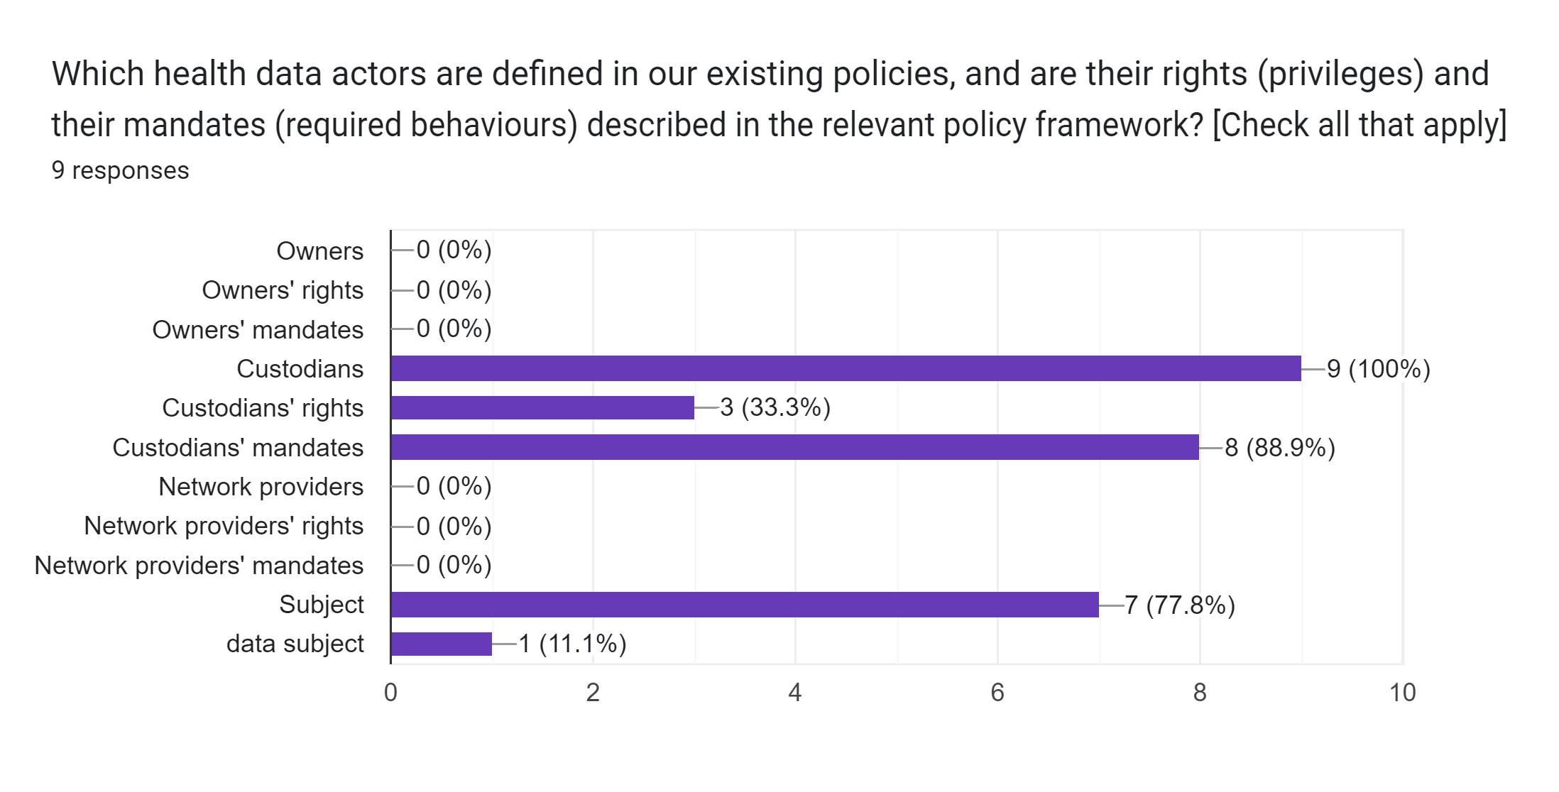
Interaction 4.1

Slide 17
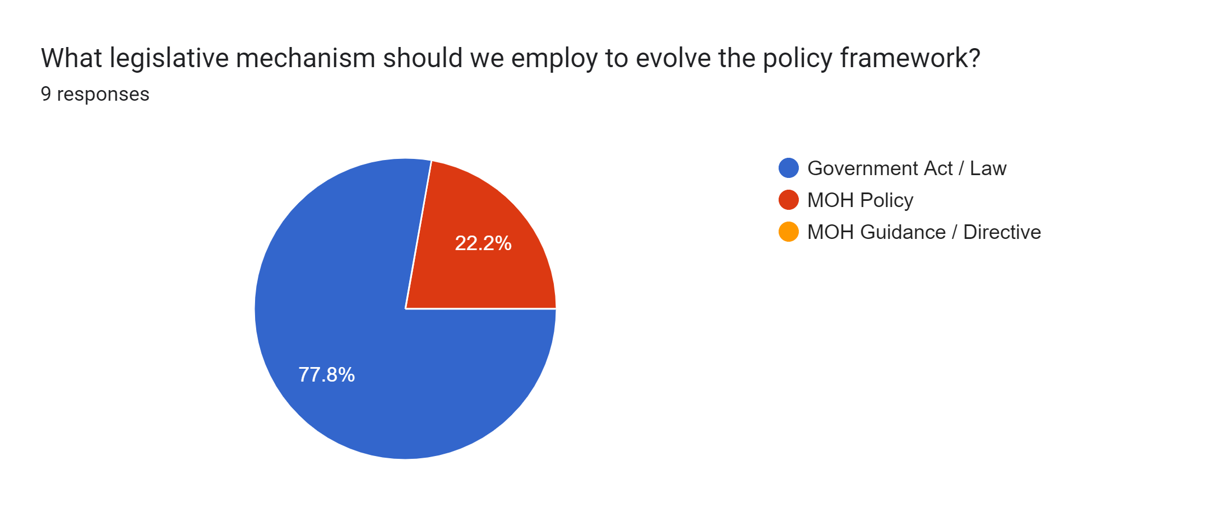
Interaction 4.1

Slide 18
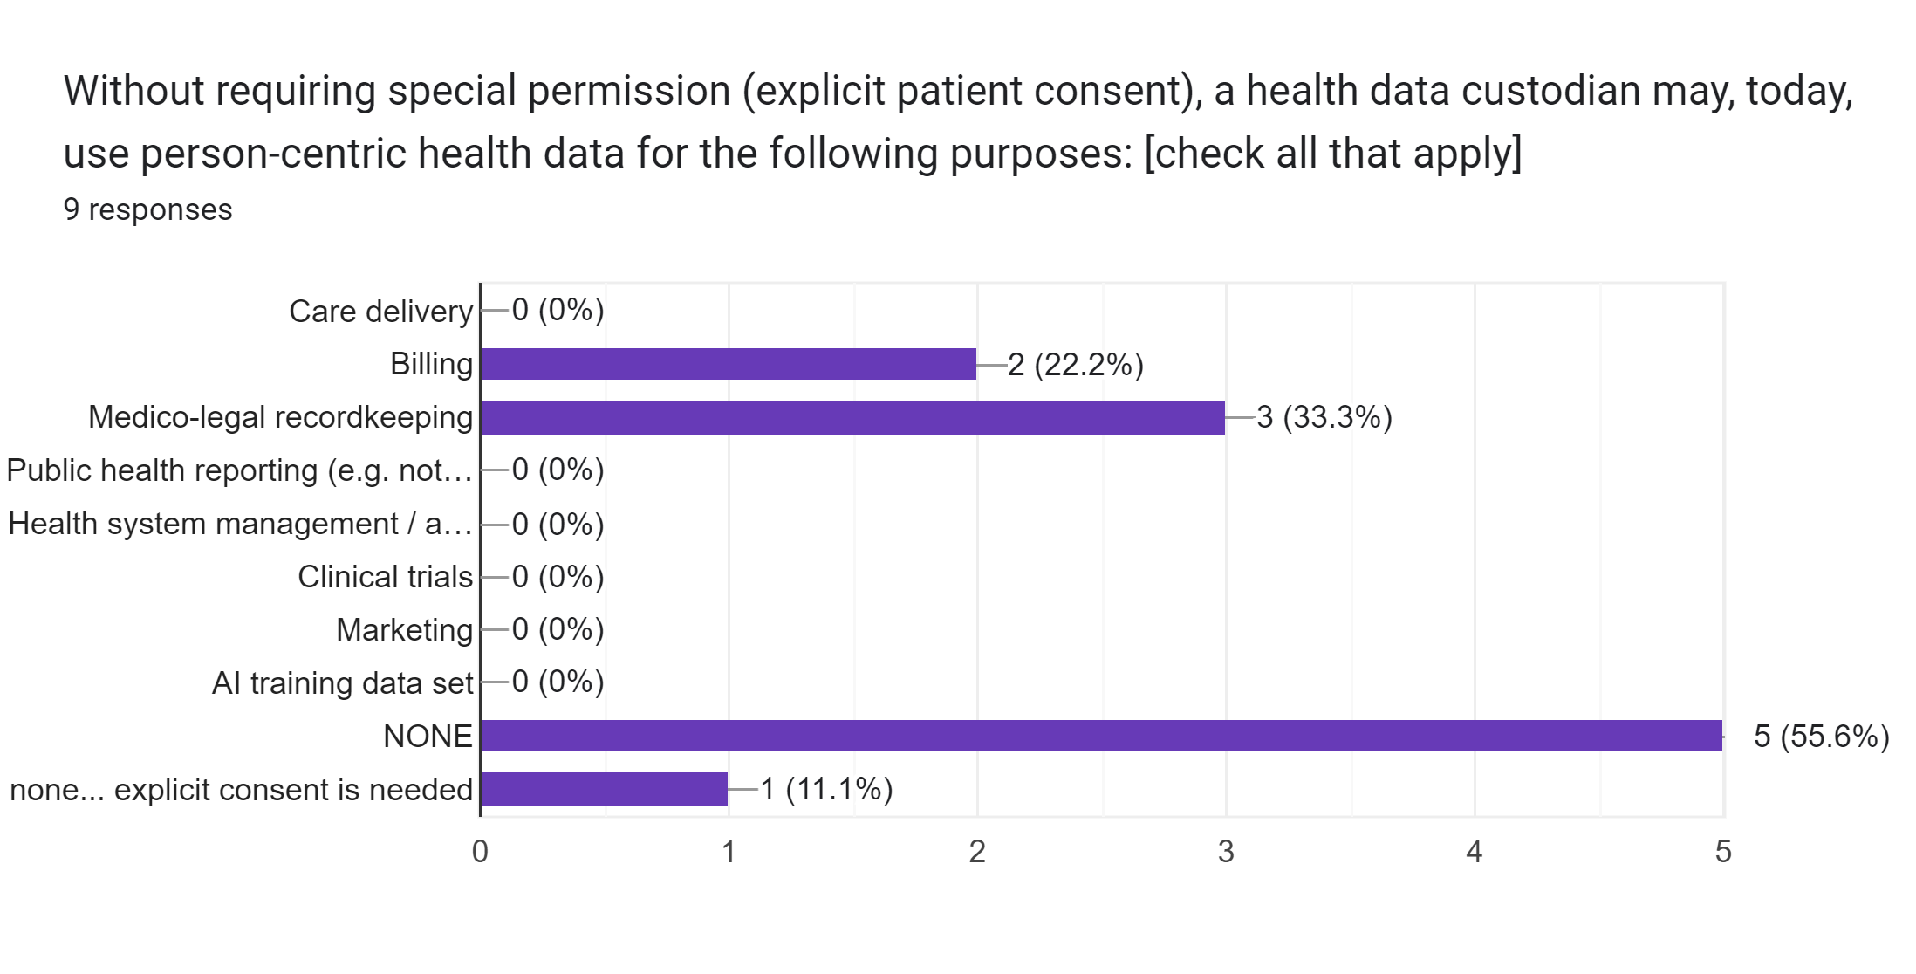
Interaction 4.1

Slide 19
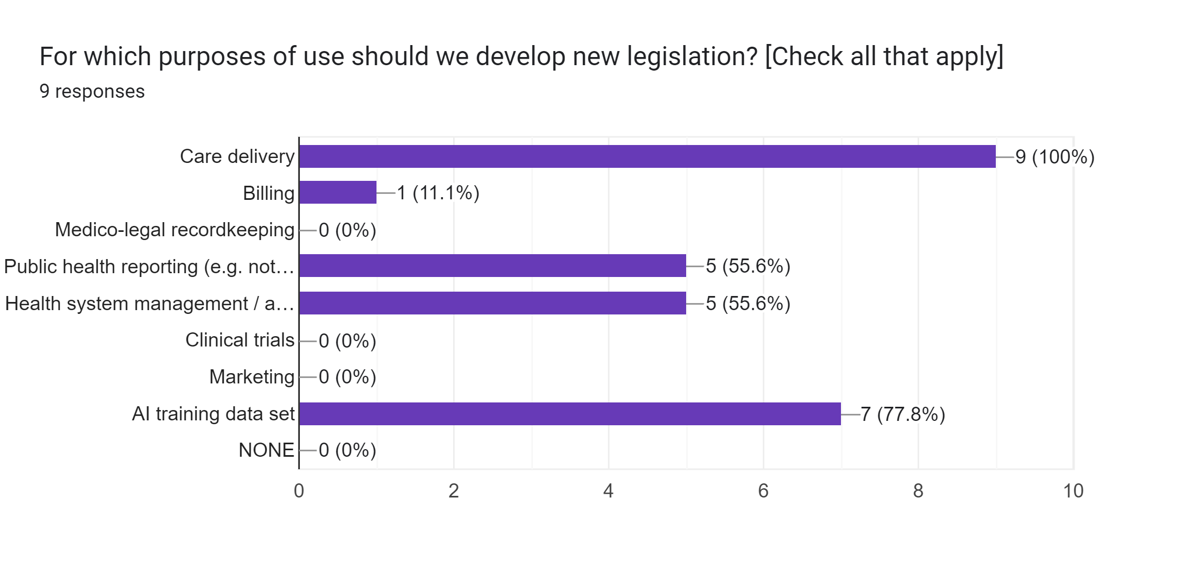
Interaction 4.1

Slide 20
What would we typically expect to be the policy basis related to person-centric health data sharing?

Slide 21
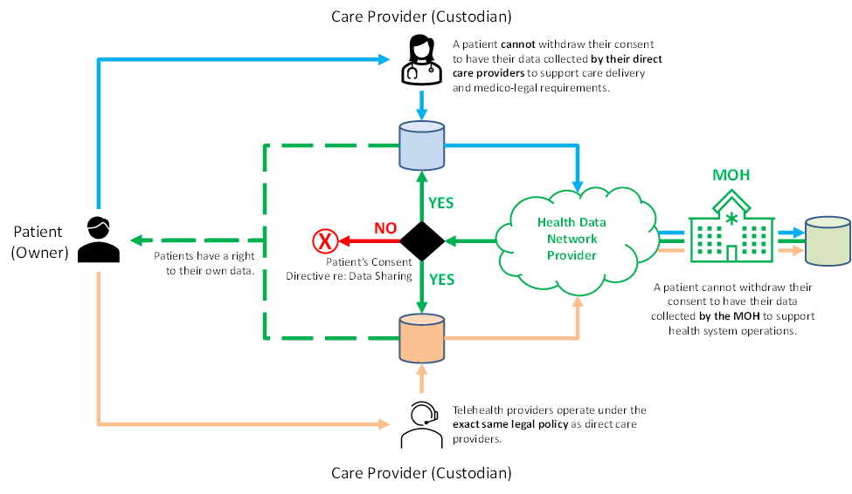
Data sharing

Slide 22
Data sharing policy options
Opt-in – a client must explicitly give informed consent. Without this consent, their health data is not shared.
Opt-out – unless a client explicitly withdraws their consent, their health data is shared.
BTG – a care provider may, with explicit reasons given and logged, override the client’s consent option (“break the glass”).
Circle of Care – the scope of a client’s consent is applied to care providers in their circle of care. This circle can be broadly defined (entire care network) or narrowly (explicit list of care providers).
Purpose of Use – the scope of a client’s consent will apply to select purposes. Commonly, care delivery is the only permitted use unless other purposes are specifically consented to (e.g. clinical trial, research, etc.).

Slide 23
Data Sharing Recommendation
For implementability, an opt-out/no-BTG/whole-network/care-purpose consent policy is highly recommended:
By default, a patient’s data will be shared within the entire care delivery network for the purpose of delivering care with no overrides.
A person must have the right to withdraw their consent to have their data shared. They cannot withdraw their consent to have their data collected.
As a matter of governance, and to fulfill its fiduciary duties, the MOH (via the HIE) should be legislated as a mandatory custodian.
By default, and with only a few exceptions, a Custodian should permit a person to have access to their own health data.

Slide 24
Data sharing
As a matter of fiduciary duty, all patient data should be persisted to the MOH’s HIE.
National
HIE
To support care quality and patient safety, the recommended default is to share unless a person has explicitly withdrawn their consent.
As a practical matter, the MOH may decide to operate a patient portal.

Slide 25
Data blocking
Many jurisdictions have struggled with challenges of private sector care provider data blocking – where patient health data is intentionally not shared to the HIE.
It can be useful to frame this as a patient rights issue. Each person has a right to patient-safe, high-quality care; this right relies on their health data being shared within the care delivery network.
National legislation defending patient quality of care can serve as anti-data-hoarding legislation.

Slide 26

Systems engineering principles
Optimize the design around the systemic default use cases.
Introduce exception-based processing as needed.
Exceptions are not allowed to break the system.
Any proposed exceptions to the data-sharing policies should be mindful of these principles.

Slide 27
Key takeaway points:
Our default system behaviour should be that digital health infrastructure is leveraged in support of providing patient-safe, high-quality care.
A citizen may opt-out of the default behaviour (data shared for care delivery purposes), but they may not opt-out of data collection.
All the providers in the care network – both public and private sector – need to participate in data sharing. To not do so is a patient safety and quality of care issue.

Slide 29
Interaction 4.2
<paste Google Form link, here>
Do our existing consent policies support broad, person-centric health data sharing?
What legislative mechanism(s) should we employ to evolve the data sharing policy framework?
Do we have effective instruments of governance over the private sector care network?
Will we provide people access to their own HIE data holdings; if yes, how?

Slide 30
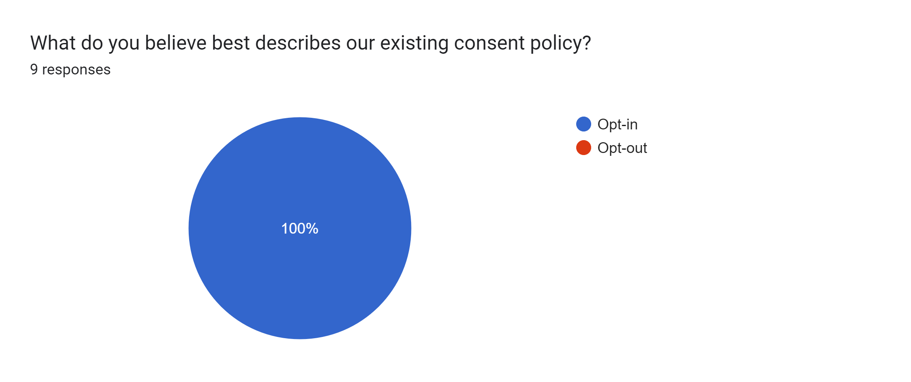
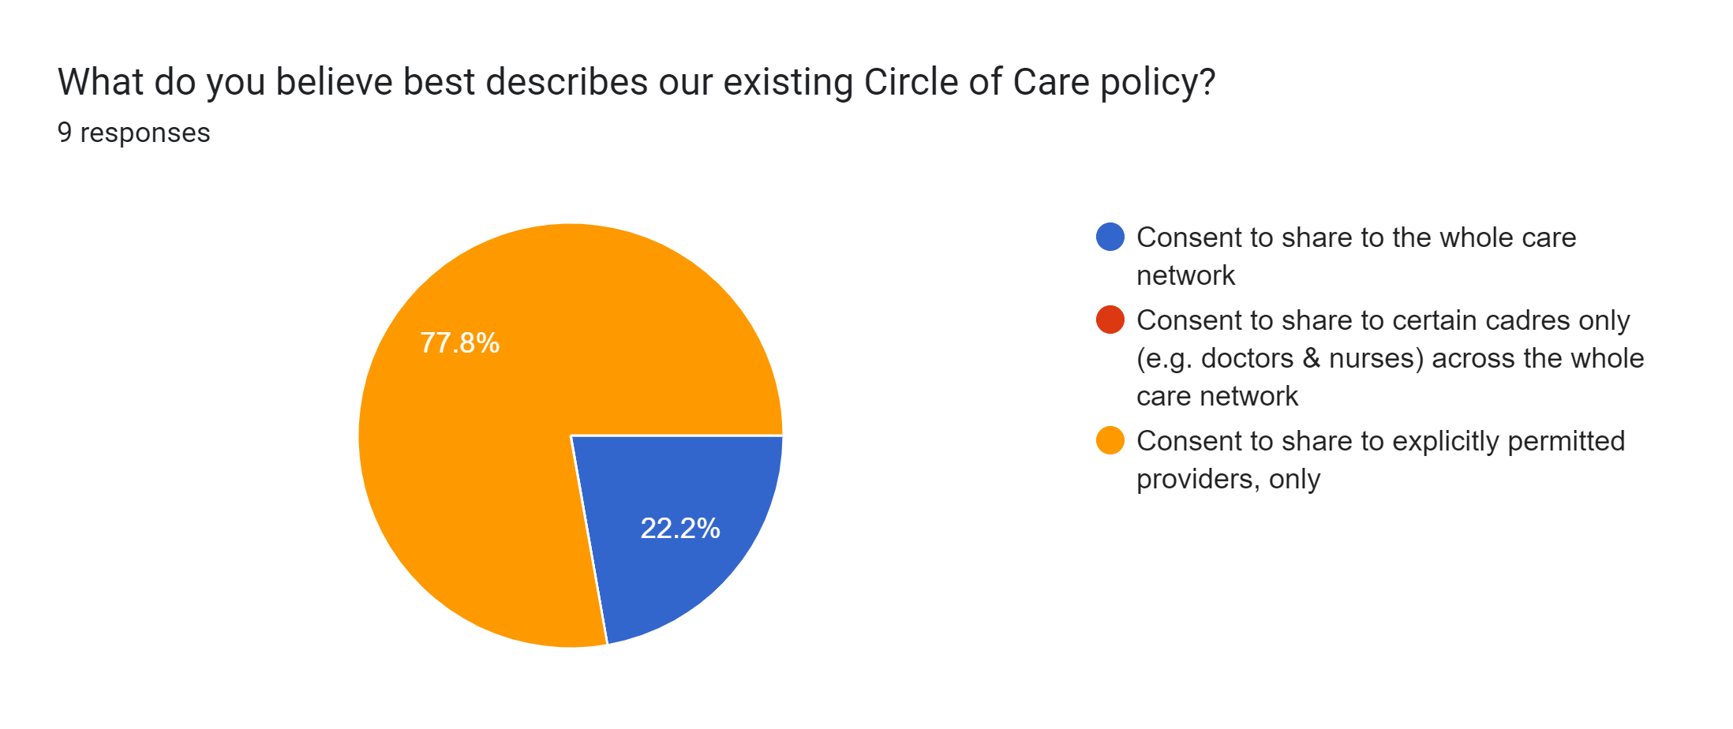
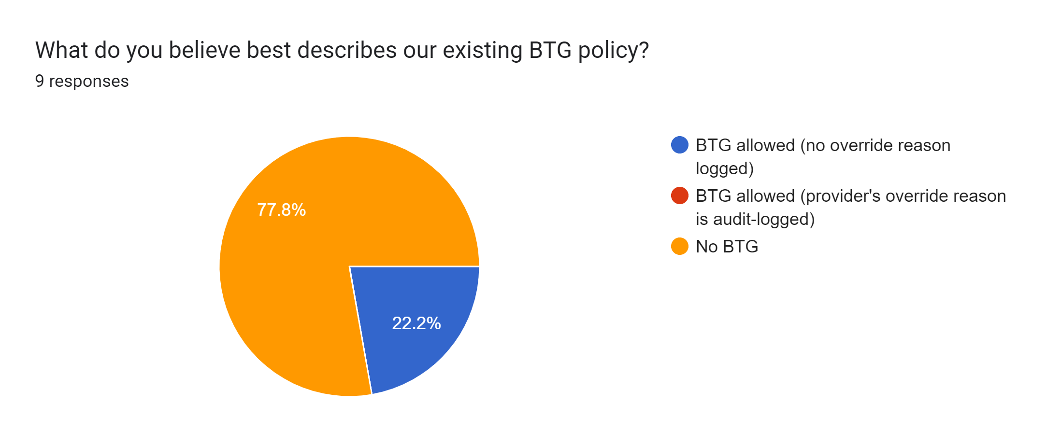
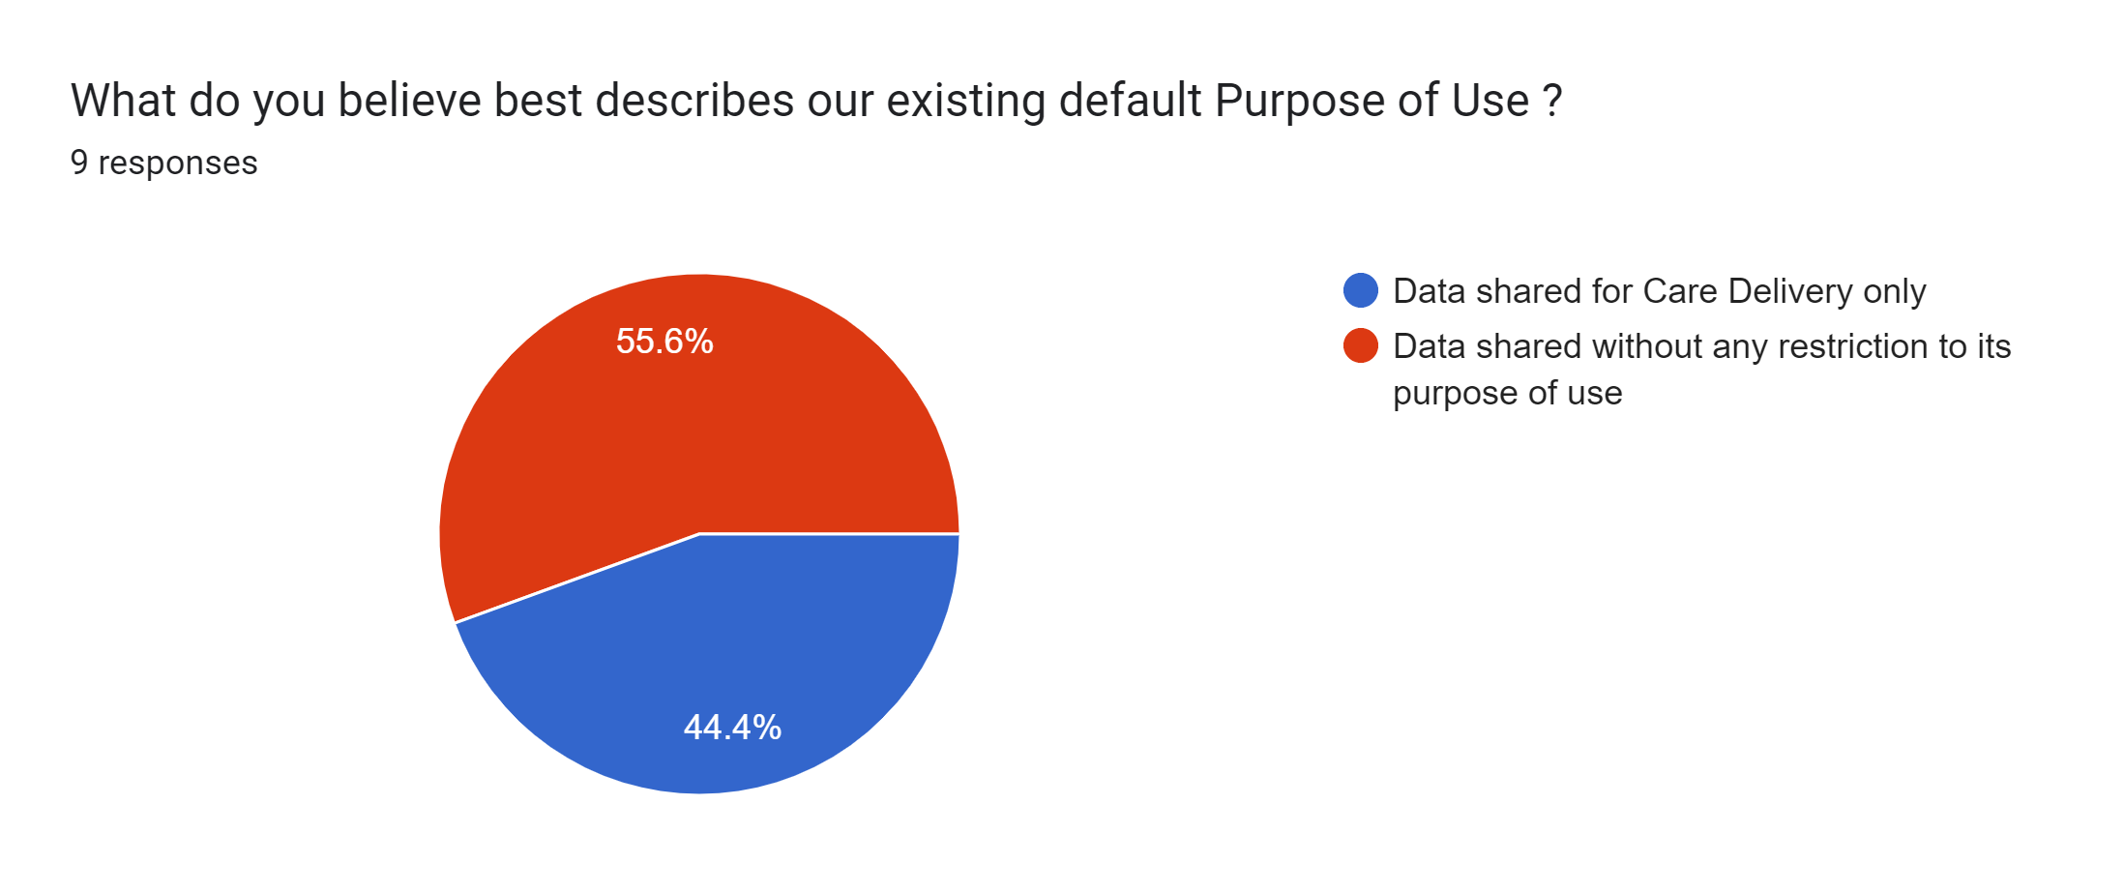
Interaction 4.2

Slide 31
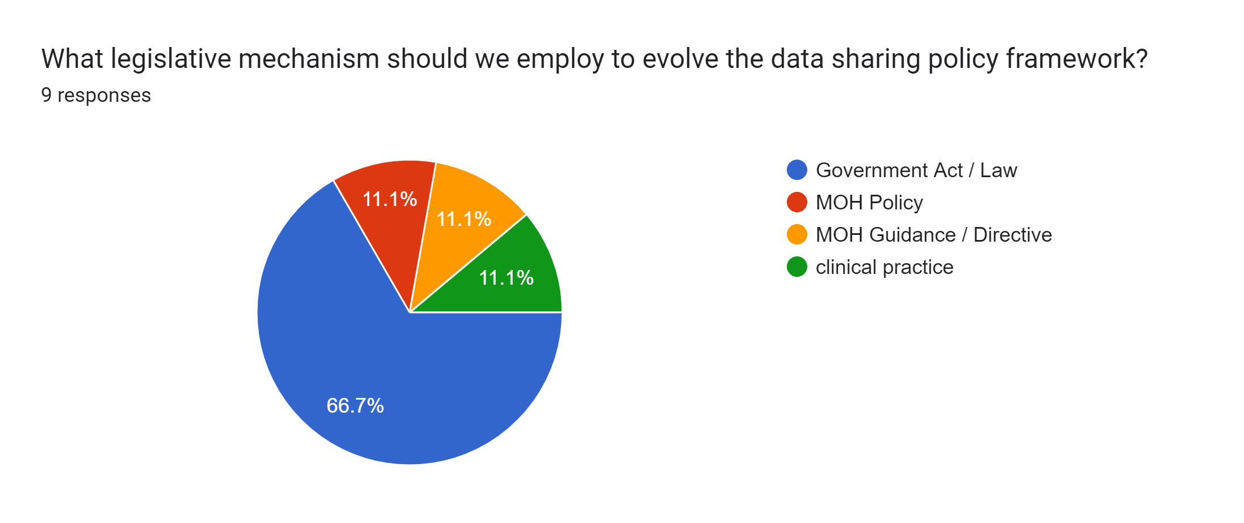
Interaction 4.2

Slide 32
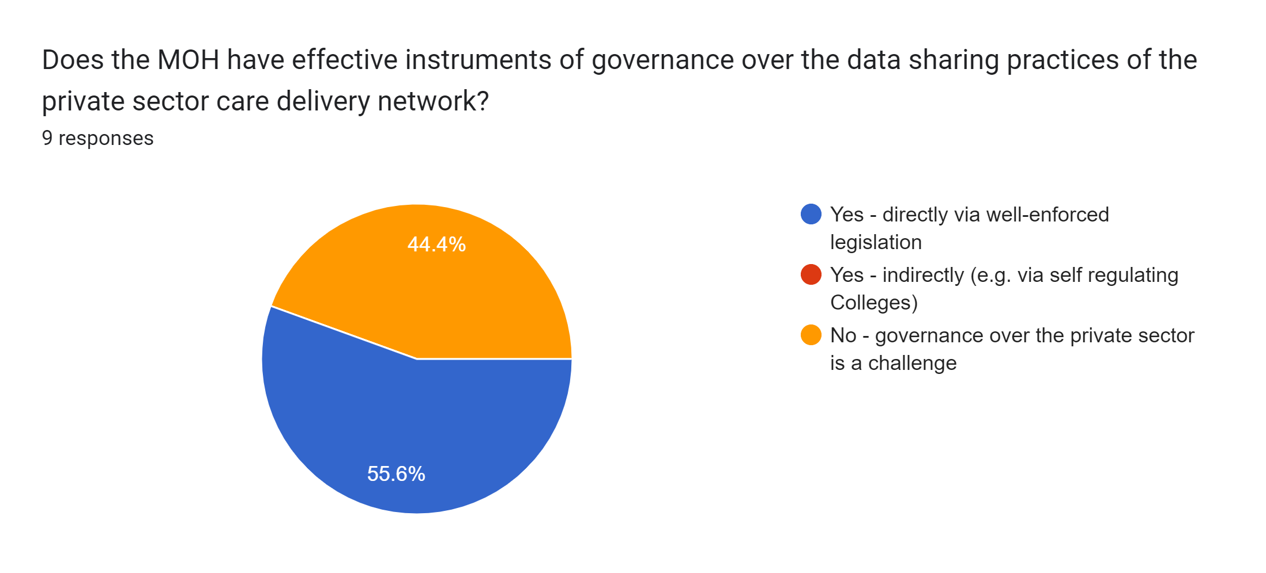
Interaction 4.2

Slide 33
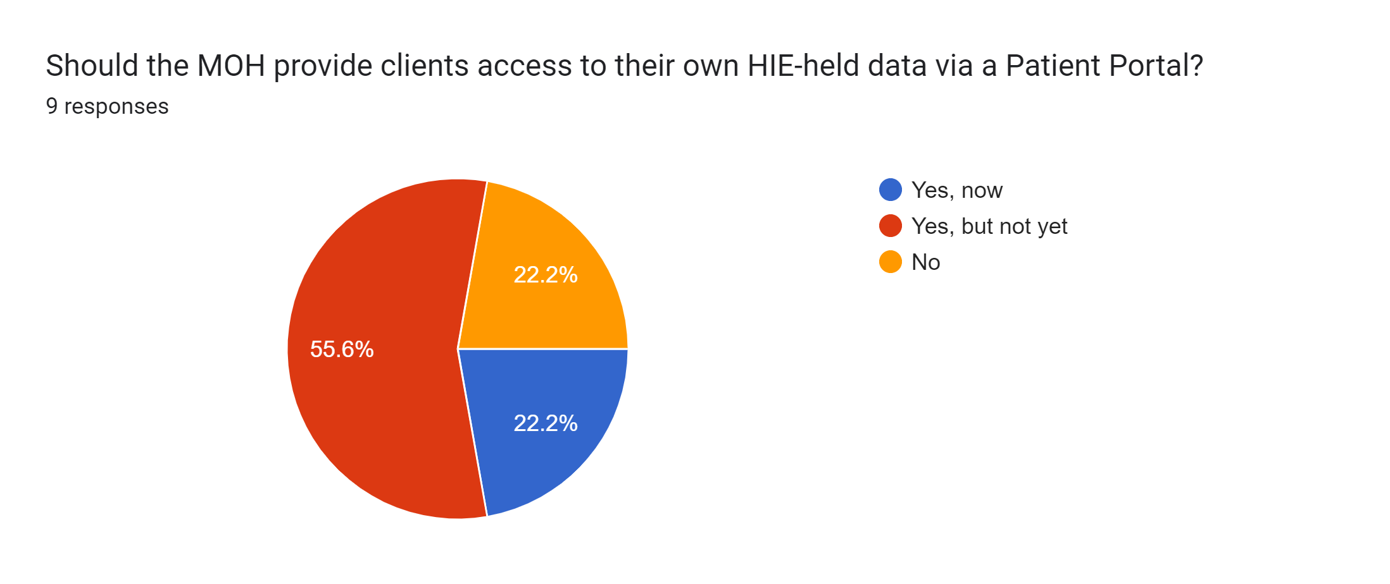
Interaction 4.2

Slide 34
What is the current context regarding digital health programme management?

Slide 35
What are the current practices?
<leverage a desk review and pre-workshop interviews with MOH and other relevant stakeholders to determine the current programme management practices related to digital health implementations. Prepare a succinct description of the findings.>

Slide 36
Identified RISKS
Identified Risk | Level | Mitigation Strategy
Inflation | Very high | Peg costs to USD
Weak coordination | High | Ensure active governance structures
Inadequate human resources for implementation | High | Begin staff recruitment
Inadequate financial resources for implementation | Very high | Lobby government and partners for increased funding
Overreliance on external funders | Very high | Lobby government to increase proportion of funding for digital health Explore public-private partnership opportunities
Financial management | High | Enforce adherence to management guidelines via strong M&E
Misalignment of priorities between donors and MOH | High | Adhere to guidelines re: introducing new innovations
Non-compliance to SOPs and digital health standards | High | Enforce adherence to guidelines re: digital health solutions
Inadequate digital health awareness | High | Sensitization campaigns at all levels of the health system
Rapid changes in digital health developments | High | Participate in local and international events; enhance R&D efforts
Low ICT penetration | High | Invest in infrastructure development
Digitalization of inefficient core processes | Very high | Lobby for government to conduct BPR efforts
Unreliable power grid | Very high | Invest in adoption of alternative power options
Digital system fragmentation | High | Strengthen coordination and compliance to guidelines and harmonization
Resistance / slow adoption of digital health | High | Implement change management and capacity building strategy

Slide 37
Governance & coordination
The implementation of digital health shall be led by the Directorate of Quality Management and Digital Health in the Ministry of Health. Within the directorate, the Digital Health Division will be the responsible implementation unit. The head of the division shall report to the Director for Quality Management and Digital health who in turn shall report to the Secretary for Health. The QMD shall work hand in hand with the departments and programs within the Ministry to ensure alignment and integration of digital health interventions.

Slide 38
Coordination structure
The decision processes and coordination for digital health will be supported by permanent structures and temporally structures. The key structures in the framework are the Digital Health Steering Committee, the Digital Health Technical Working Group and its subgroups. The steering committee is the high-level investment coordination structure while the TWG is a technical coordination team comprising the government, development partners and the private sector. The sub TWGs will be designated by the main TWG and where necessary, the sub TWGs can designate some technical work to task forces. The terms of reference for these structures are articulated separately in a document describing digital health leadership and governance.

Slide 39
What are some important considerations regarding how to govern our HIE implementation programme management?

Slide 40
Underlying Principles
As a practical matter of cost-efficiency, it is important to coordinate the efforts of all relevant digital health stakeholders.
As a practical matter of HIE governance, all digital health initiatives need to be adherent to the national digital health norms and standards.
As a matter of sovereignty, initiatives should serve the national health and digital health strategies (noting the Paris Declaration on AID Effectiveness)

Slide 41
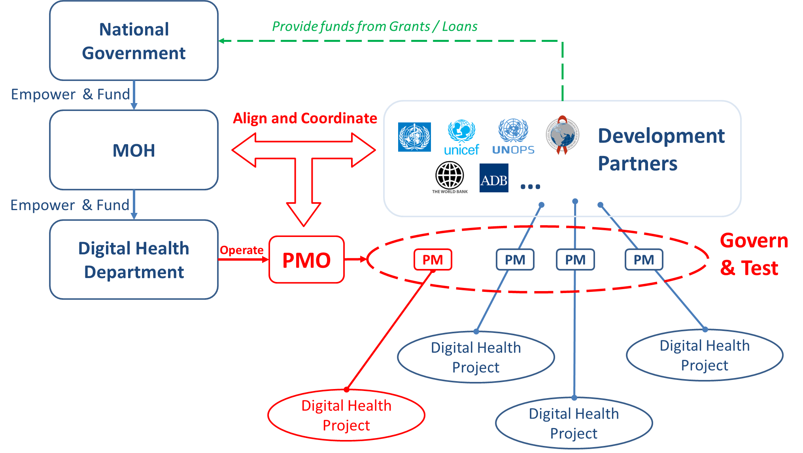
Conceptual PMO structure

Slide 42
Conceptual PMO structure
An agency or department, under the auspices of the MOH, will operate a programme management office (PMO)
The PMO will coordinate activities of the project managers (PM) across all stakeholder projects (MOH, private sector, development partner)
The PMO will govern conformance testing of digital health deliverables
The MOH will manage access permissions to the HIE

Slide 43
Key takeaway points:
Key risks have been identified and mitigation strategies are proposed to address them.
There is a governance and coordination organization chart defining roles within the MOH related to digital health.
A plan has been made related to coordination of the digital health TWG efforts within the context of the overall health sector TWG.
A steering committee is planned for that will coordinate investments (including MOH and development partners).

Slide 45
Interaction 4.3
<paste Google Form link, here>
Are there clear budget mechanism(s) that would support a national HIE construction project?
Is there, today, a way to “pool” the funding allocated to disparate digital health projects?
Is there, today, regular coordination between active digital health projects?
For a national HIE construction effort, what should be the responsible department or agency to operate the PMO?

Slide 46
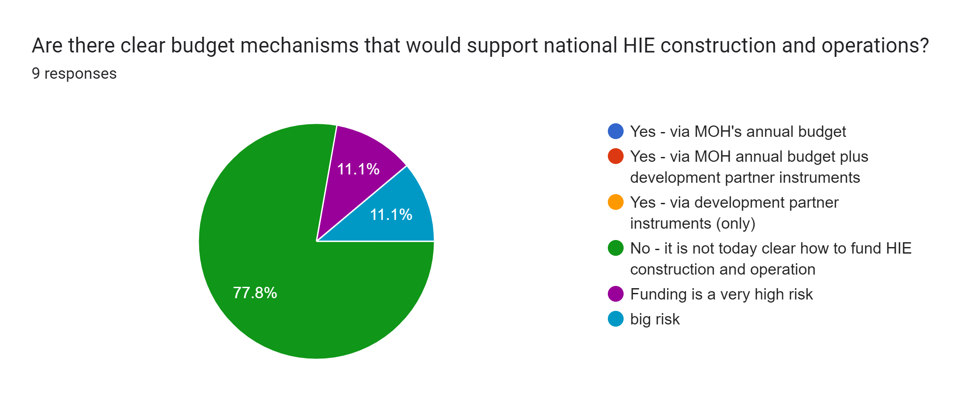
Interaction 4.3

Slide 47
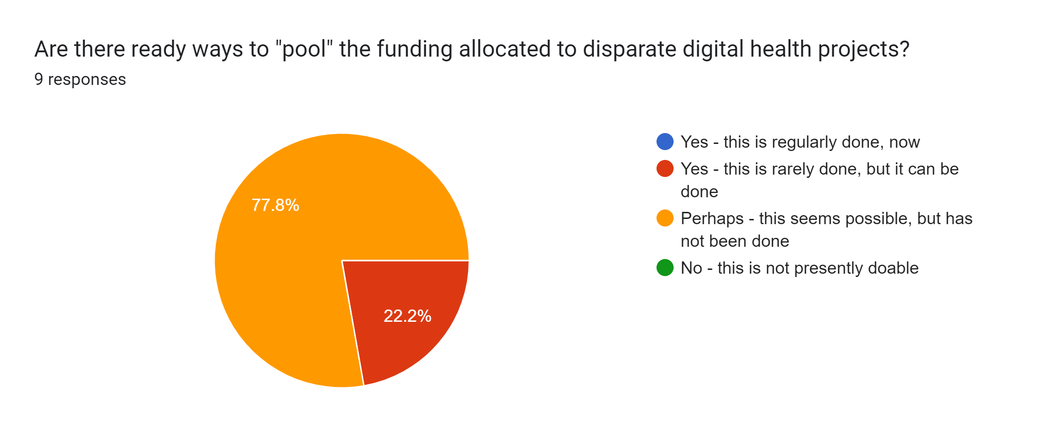
Interaction 4.3

Slide 48
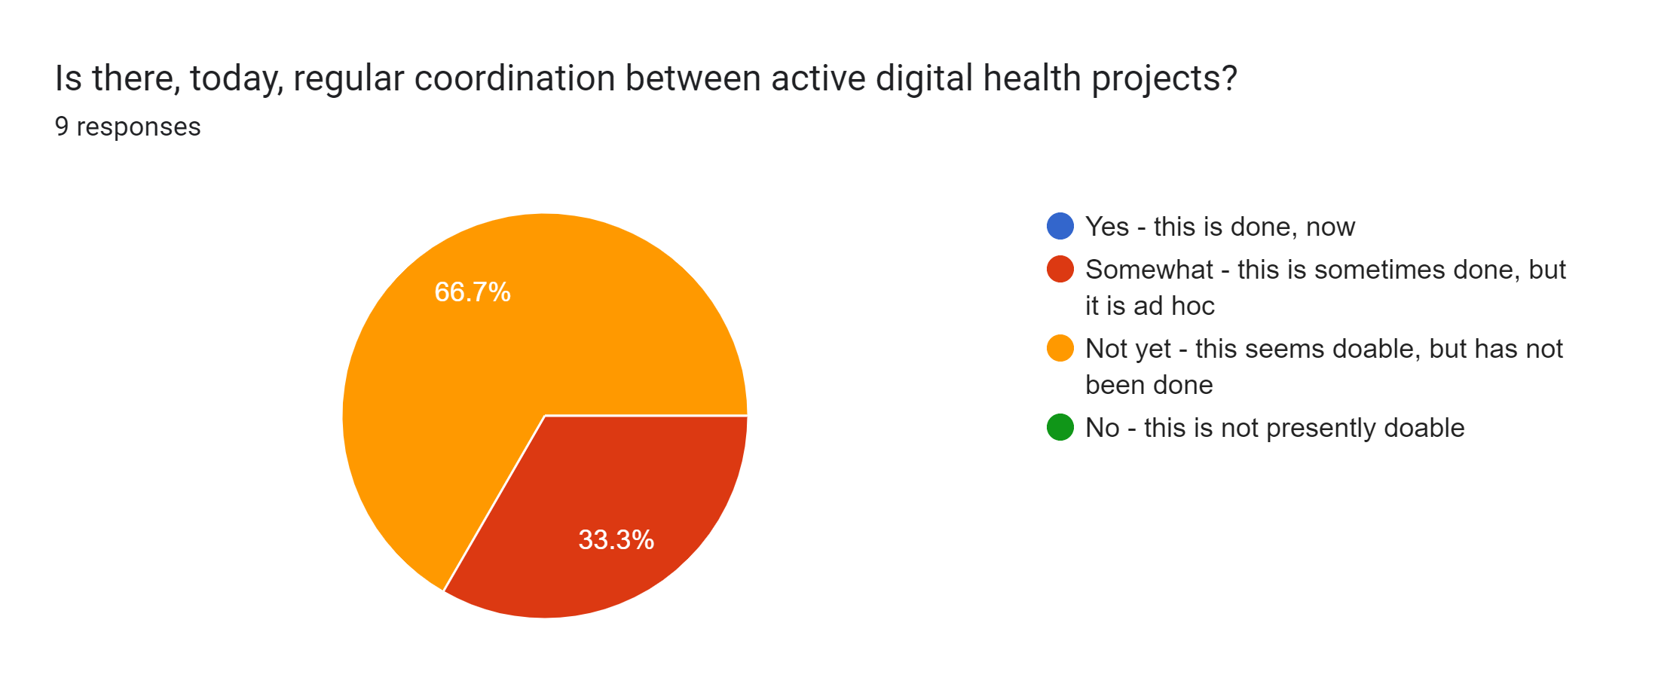
Interaction 4.3

Slide 49
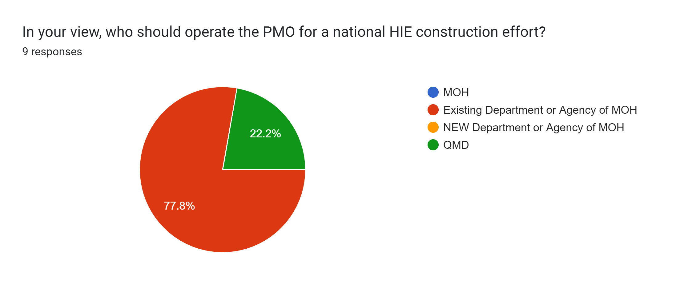
Interaction 4.3

Slide 50
What are contextual metrics will drive the cost and pace of our HIE’s implementation plan?

Slide 51
What is the current situation?
<leverage a desk review and pre-workshop interviews with MOH and other relevant stakeholders to determine the numbers and types of facilities, number of health workers (by each type), population size and annual growth rate, inflation rate, typical hourly rate for ICT support, etc. Use the data entry fields on the Investment Case tool as a guide for what to seek out. Prepare a succinct description of the findings.>

Slide 52
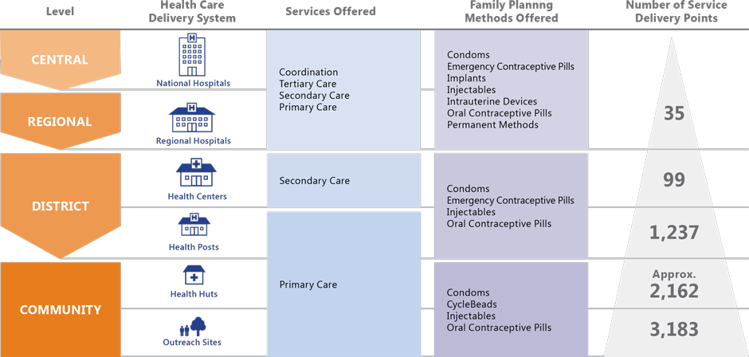
Care delivery facilities
Group-1
Group-2
Group-3
Group-4
5345

Slide 53
Health human resources
Total health workforce (est.):
(0.703 +
3.181 +
0.08 +
0.112)
* 15.1 M total population
/ 10,000
= 6155

Slide 54
Key socio-demographic details
Population 15.1M (annual growth rate 2.6% est.)
Annual inflation rate: 9%
GDP per capita: $1600 USD
Annual health expenditures per capita: $71 USD
ICT wage est.: $655 USD / mo. ($4 / hr.)
14 medical regions; 78 health districts

Slide 55
What approaches can help us build and sustain momentum on a national HIE construction project?

Slide 56
Principles
To generate interest and set up for significant value capture, choose a set of initial guideline-based care pathways that matter (e.g. high ranked in the IHME top-10 list of burden of disease).
Create a network effect:
Implement the HIE, first.
Implement a rapid (real time) CR onboarding process.
Set up conformance testing.
Connect waves of conformant POS solutions at a time.
Try to bring entire referral networks onboard at the same time.
Try to import siloed data holdings to accelerate care continuity.

Slide 57
Implementation cost & time drivers
HIE infrastructure costs will tend to have an installation/one-time fee plus an operating fee. This will be typical for the cloud-hosted HIE services and for façades and integrations to legacy solutions.
Adoption costs will be driven by the number of:
Clients – health ID “credential” to be issued at first care visit, and regularly refreshed
Facilities – attributes collected and regularly refreshed; POS solutions implemented and operated
Care providers – attributes collected and regularly refreshed
terminology updates – code lists published, and POS solutions updated
indicator report submissions.
Costs will accrue immediately, but benefits will not accrue until “critical mass” is reached – this is an incentive to implement quickly.
Inflation, if it is high, adds a further incentive to go quickly.
Ongoing governance and management costs must be accounted for.

Slide 58
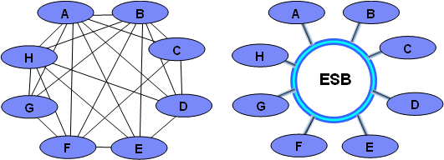
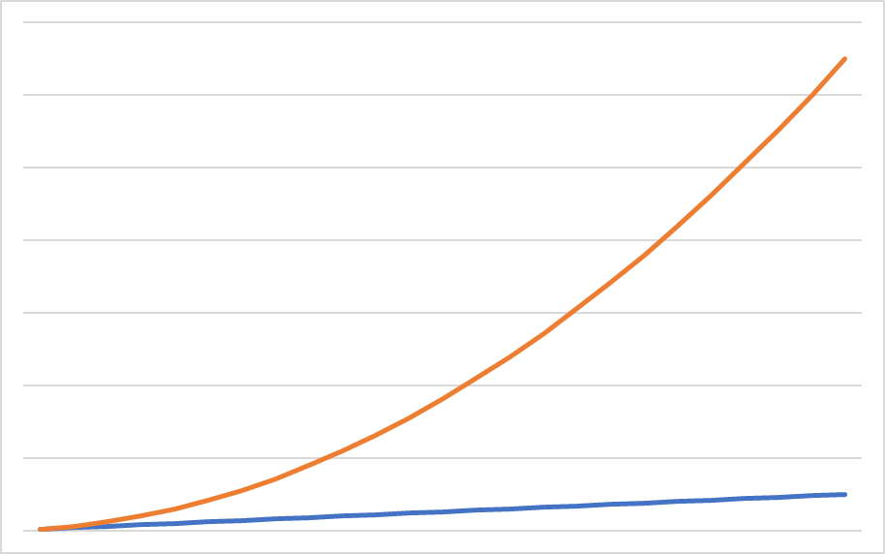
Implementing the HIE first addresses the permutation and combinations problem associated with of point-to-point data sharing.
Every new point of care that connects to the network can immediately share health data with every other point that is already connected. This builds geometrically increasing value and momentum as the implementation progresses.
HIE
Number of Data Sharing
Connections (value)
Number of Points of Care
on the national HIE (cost)

Slide 59
Buy vs Build HIE infrastructure options
HIE Infrastructure-as-a-Service (IaaS)
HIE “Private” Cloud
Stick-built HIE
Hybrid cloud Infrastructure-as-a-Service (IaaS) offering procured as a long-term contract from a credible cloud service provider. Multiple hosted services (including legacy solutions) packaged and operated as a single service for a monthly fee.
HIE solution stack built by a credible service provider. License fees and annual maintenance fees may apply. Entire HIE stack is hosted on an infrastructure operated and maintained by MOH.
Stick-built HIE solution with a software stack constructed and maintained by MOH. HIE elements are hosted on infrastructure operated and maintained by MOH.

Slide 60




Health ID credential options
4-digit PIN
ID#:
Name:
DOB:
Sex:
Mother’s Name:
123456789
Able Baker Chow
1990-06-15
M
Isabel Mwani Chow
ID#:
Name:
DOB:
Sex:
Mother’s Name:
123456789
Able Baker Chow
1990-06-15
M
Isabel Mwani Chow
A simple pre-barcoded card with key demographics either typed or handwritten in can be effective. If put in a plastic sleeve, these can be an inexpensive and durable option. If a PIN is associated with the card’s ID#, these can provide two-factor authentication.
Printed plastic cards that include a person’s picture add forgery protection and support two factor authentication. Photo capture and card printing requires special equipment.
Biometric options such as iris scans or fingerprints may be leveraged for adult persons. Collecting the scans and deploying readers at scale can have non-trivial cost implications.

Slide 61
Digital health human-resource capacity
The health informatics “bench strength” may need to be augmented.
As an underlying assumption, it is expected the MOH should first focus on short-term investments in strengthening capacity around digital health use and not in software development or implementation capacity (which is typically a one-off cost, and a good candidate for being outsourced).
Long-term investments should be made in educational programmes; these will pay dividends as “technology refresh” cycles come up in the future.
Recommended focus areas should target:
Data use for decision making by frontline workers and by MOH managers
Software solution end-user training
Health informatics education programmes (e.g. college, university)

Slide 62
Data use
Capacity-building programmes should focus on:
Frontline workers’ use of data to drive care workflows
Health system managers’ use of data to drive decision-making regarding, for example, data infrastructure operations, human resource allocation, supply chain management, supportive supervision, disease surveillance, etc.
Building an appetite for data will drive adoption of digital health solutions that can provide these data.
This education should be software solution-independent. It should be applicable across all products.

Slide 63
POS solution end-user training
Re-usable POS platforms (e.g. primary care EMRs) are to be preferred over a proliferation of single-purpose apps. Where multiple care paths are supported on a single platform, economies of scale are enjoyed regarding support costs and frontline worker training burden.
Total Cost of Ownership (TCO) should drive POS solution procurement.
End-user training should be a key consideration in developing comparable TCO metrics across multiple POS solution options. Easy-to-use software is, economically, worth a lot.

Slide 64
Academic Programmes
Domestic university-level health informatics degree programmes (BSc, MSc) should be developed. This can be done in collaboration with international academic partners (e.g. U of Cape Town, Johns Hopkins, York U, U of Edinburgh, etc.) and should adhere to global curricula standards.
Certificate programmes (e.g. 1-year part time) should be developed that can be adopted by mid-career professionals who wish to enter the digital health sector.
National health informatics professional credentialing programmes can be leveraged to support best practices and (potentially) regulation of practitioners in the interests of public safety.

Slide 65
Critical slice implementations
Level-3
Level-2
Level-1
As a deployment option, deploying all of the purple sites, first, will yield immediate health benefit because the whole of the referral network is implemented. Strategically grouping deployment sites can yield health benefits earlier in the implementation.

Slide 66

Patient Portal / apps
For patients, having access to their health data is very empowering. An MOH-hosted patient portal (or app) may be leveraged to accelerate adoption and build strong momentum for the HIE project.
For example – if there is not a strongly receptive attitude among private sector care providers, the patient empowerment story can be helpfully encouraging: “Once your private sector care provider is connected to the HIE, you will have your prescriptions and lab test results available on your phone.”
My IPS

Slide 67
Key takeaway points:
<List three or four key takeaway points, here>

Slide 69
Interaction 4.4
<paste Google Form link, here>
Should the MOH procure cloud-hosted HIE services, or should they stick-build their own HIE (buy or build)?
What should be the preferred health ID credential?
Are there, today, health worker databases for each cadre?
Are there, today, facility directories? Do these include information regarding resources and service offerings?
For which care pathways are there, today, digital health solutions with large patient databases?
Are there ways we can “productize” implementations to reduce the duration of a POS deployment?
How many concurrent POS deployments can the PMO support?
At what “critical mass” will we start to capture value from our HIE?

Slide 70
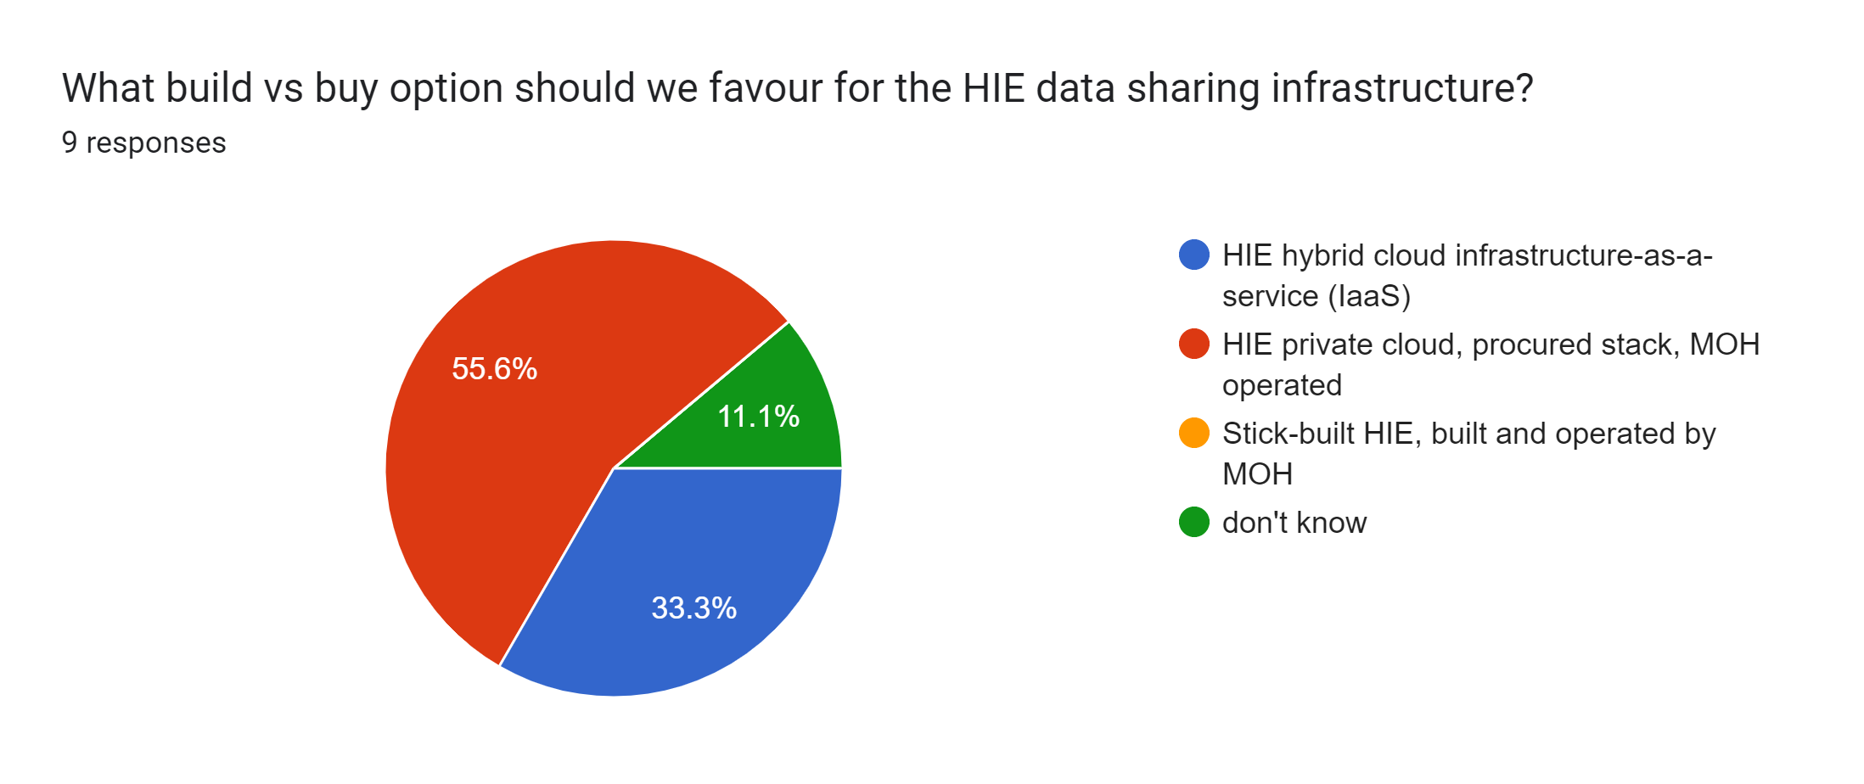
Interaction 4.4

Slide 71
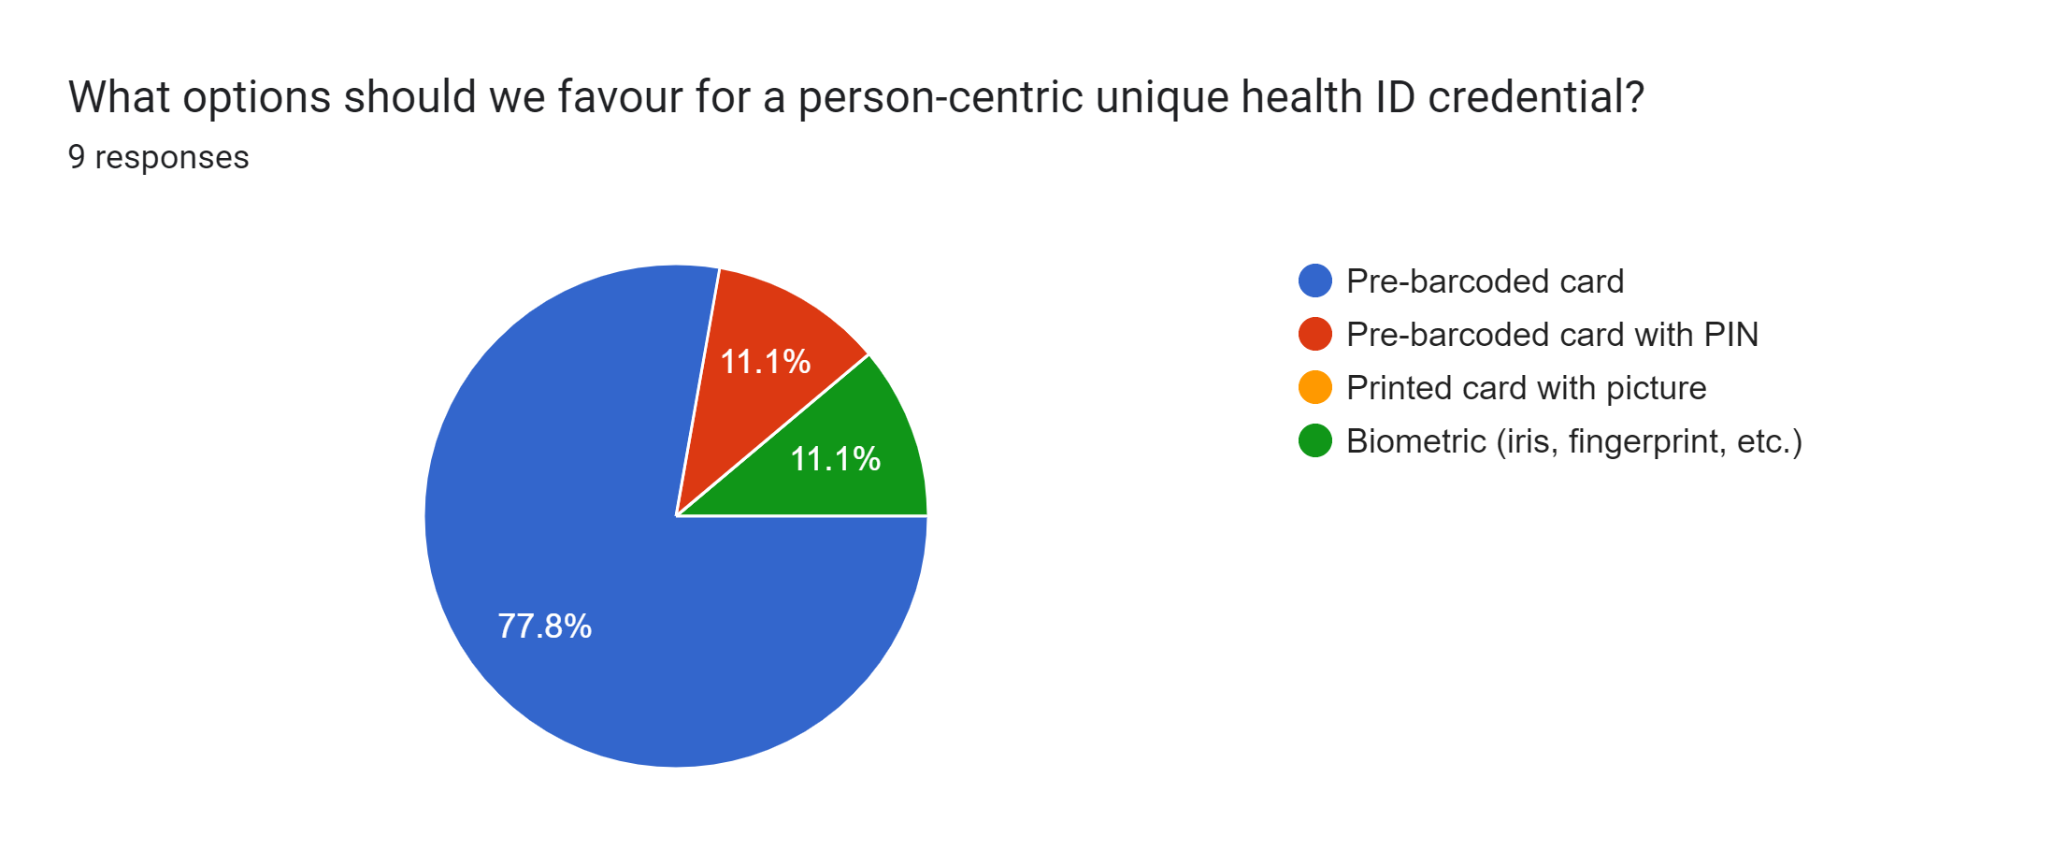
Interaction 4.4

Slide 72
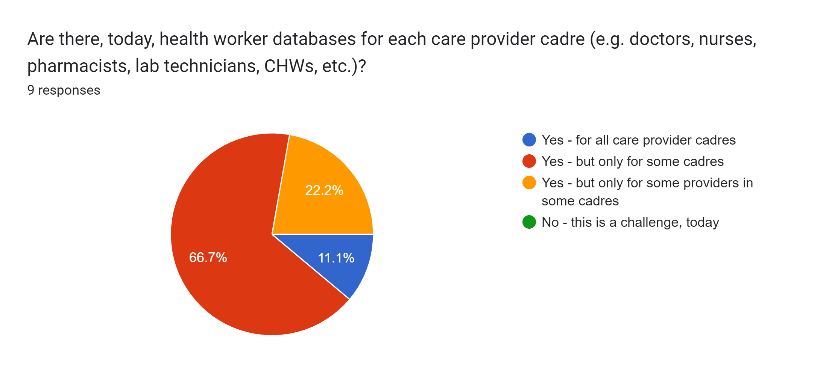
Interaction 4.4

Slide 73
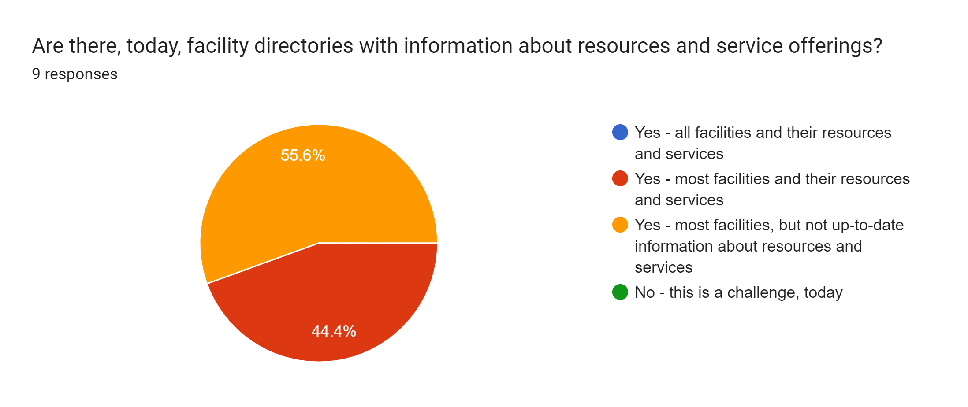
Interaction 4.4

Slide 74
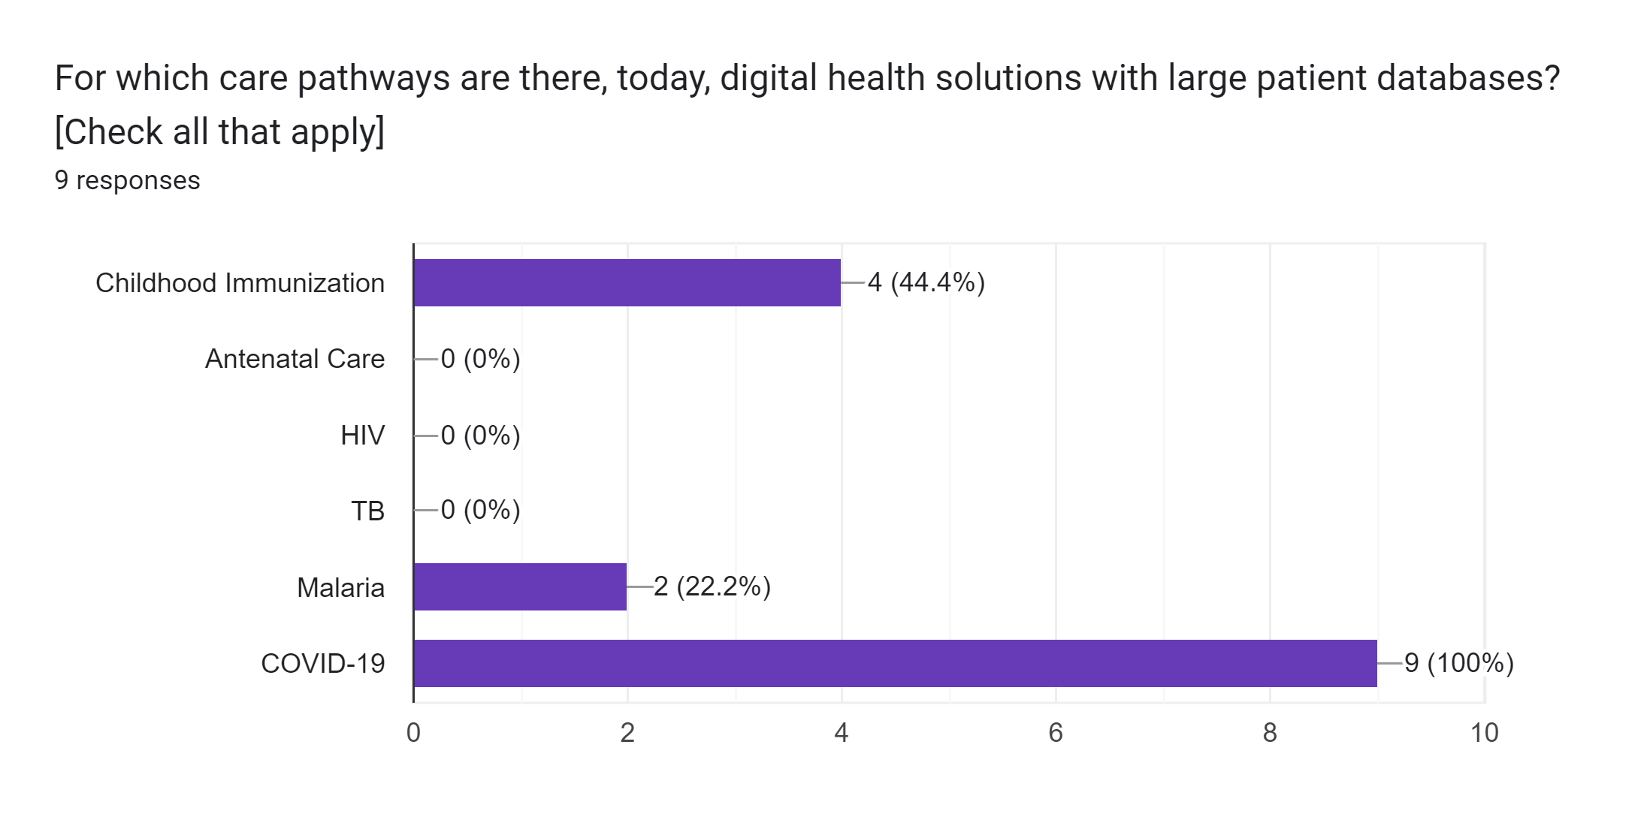
Interaction 4.4

Slide 75
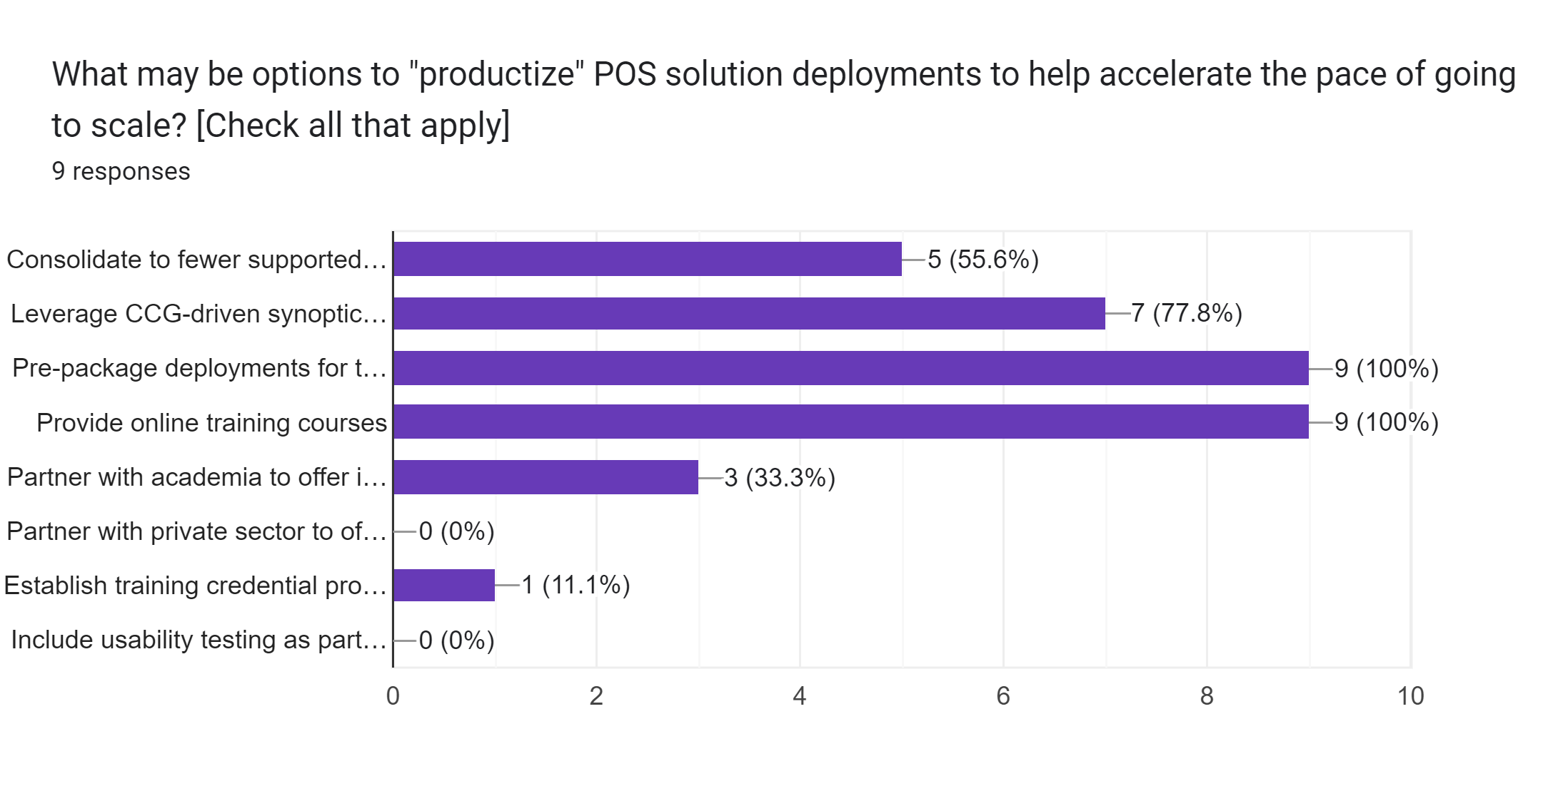
Interaction 4.4

Slide 76
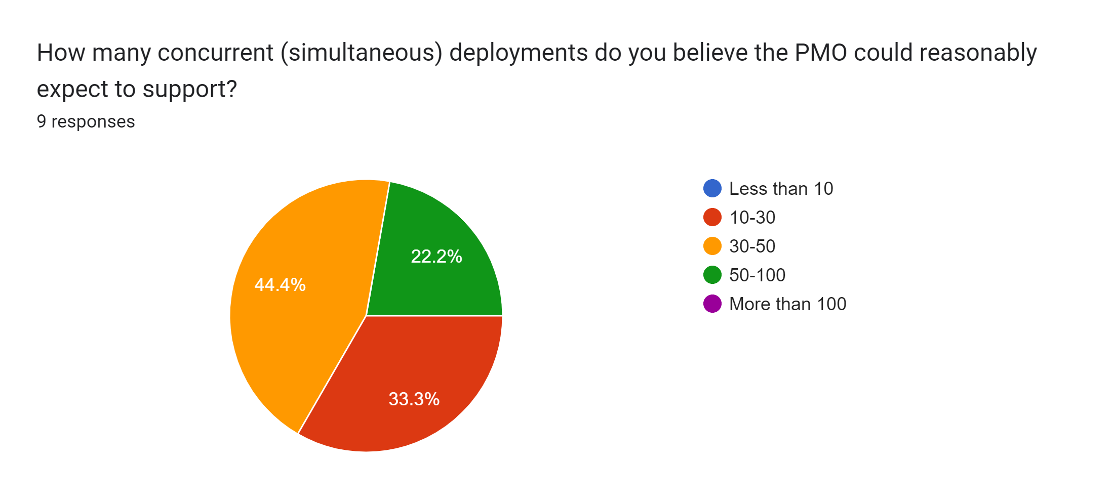
Interaction 4.4

Slide 77
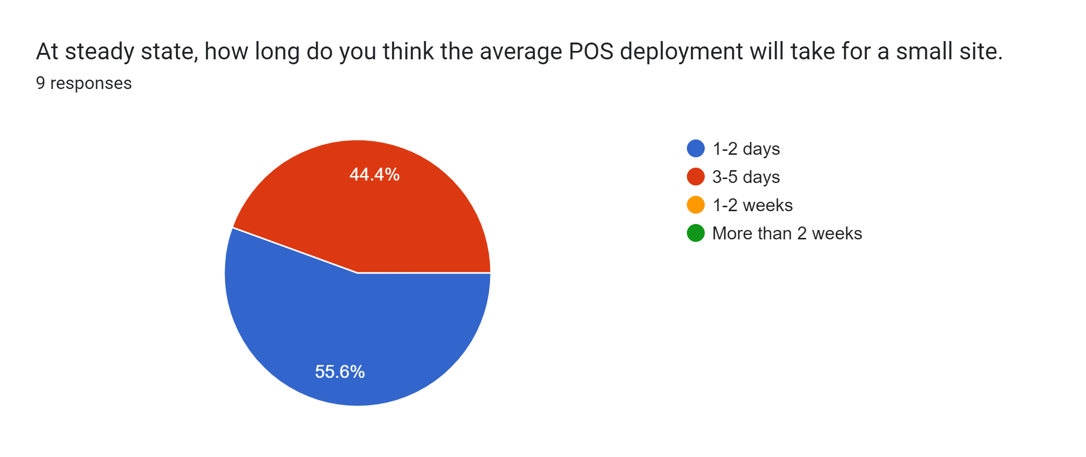
Interaction 4.4

Slide 78
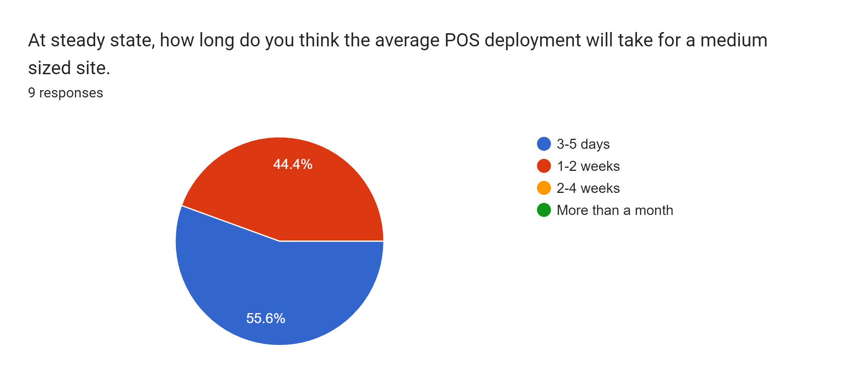
Interaction 4.4

Slide 79
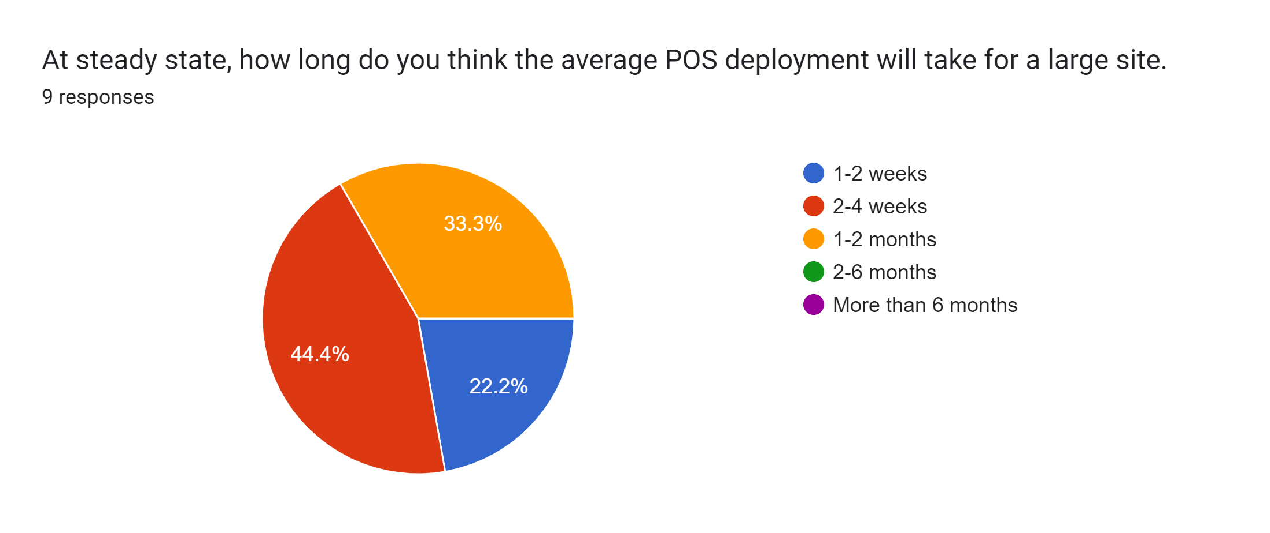
Interaction 4.4

Slide 80
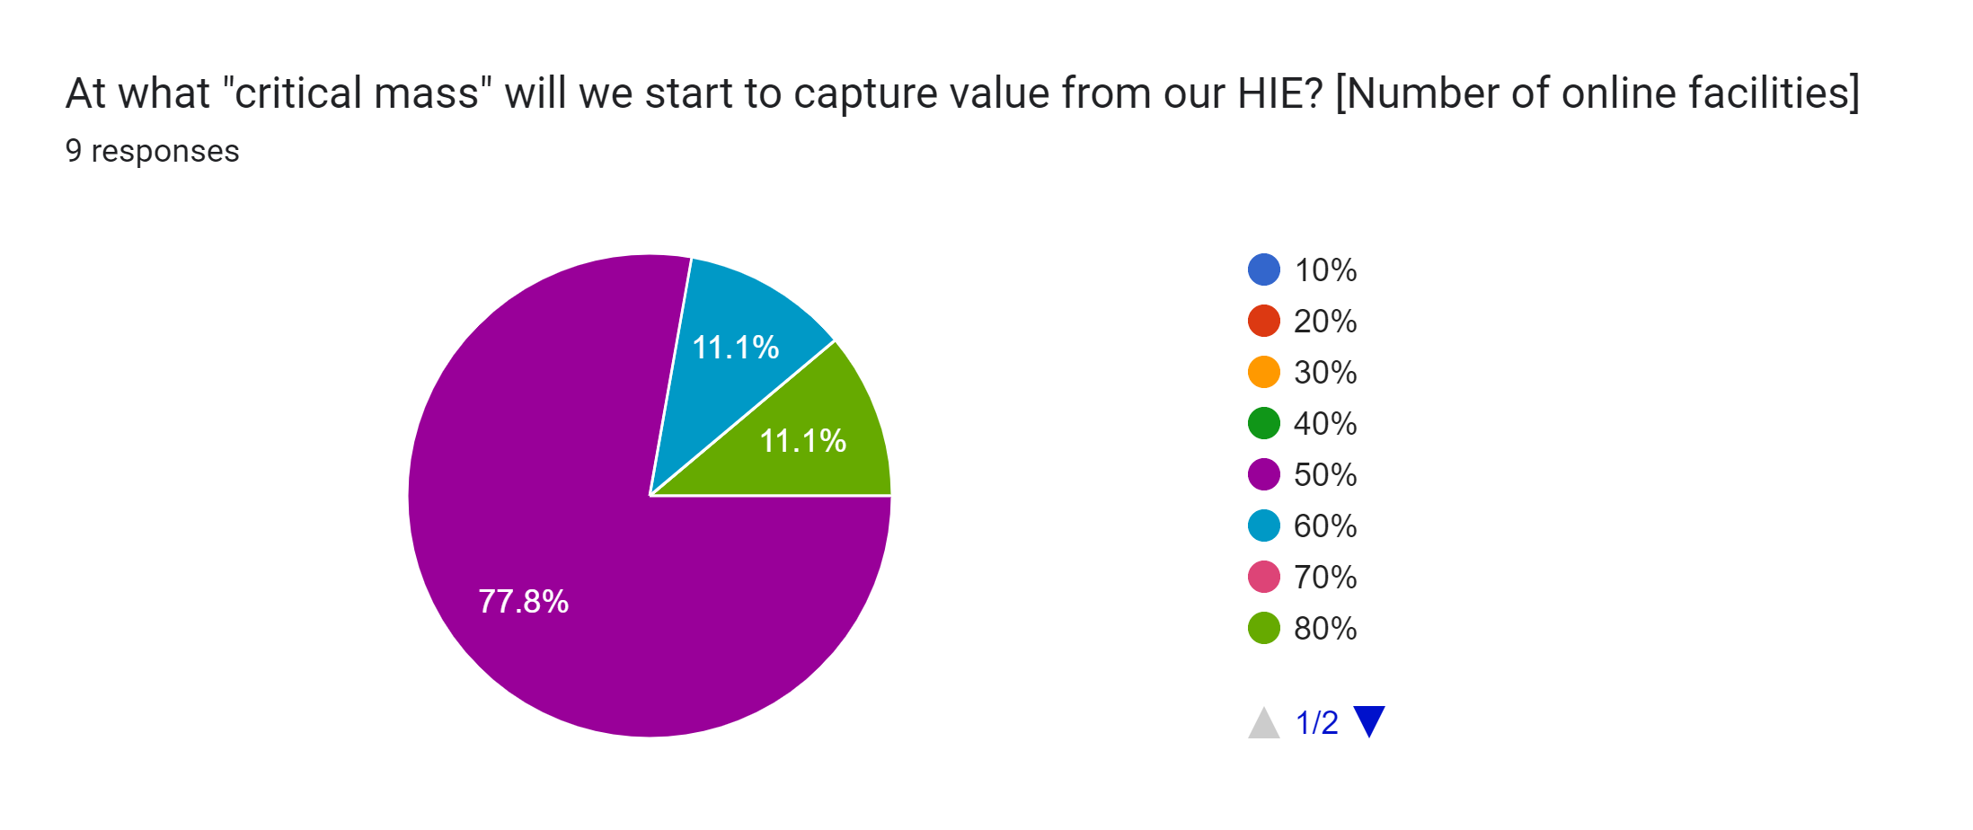
Interaction 4.4

Slide 81
Next steps: Artefacts
The inputs and feedback from these workshops will inform the development of both a “buildable blueprint” artefact along with a national HIE investment case.
The investment case will:
Leverage a high level 10-year implementation and operating plan with cost drivers that are associated with a national deployment
Target key care workflows that address the national disease burden, and estimate the health impact of workflow improvements
Develop a DOLLARS-per-DALY metric that provides the MOH with a cost-utility analysis (CUA) of the investment plan and act/adjust accordingly.

